Slide 1
Name GAN
Generate Names for new born

Slide 2
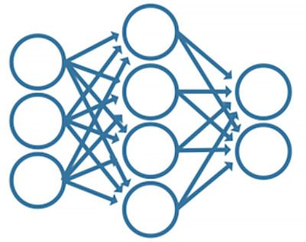
Project Introduction
software that can suggest unique and meaningful baby names for newborns.
First_name
last_name
Birth_date
Birth_place_state
birth_place_country
Father_first_name
father_last_name
Mother_first_name
mother_last_name
Gender
ethnicity
New First_name
recurrent neural network (RNN)

Slide 3
Data Gathering
The data required to train the ML model is personal and not publicly available…
Unless you are a celebrity / public figure
So I am using Movie Actors’ data for this project.
Which is publicly available on the internet.
Needed to use “BeautifulSoup”^{[1]} and “Requests”^{[2]} sometimes. Which parses HTML elements.
Data Sources:
https://ethnicelebs.com/all-celebs
https://www.imdb.com/search/name/?gender=male,female&start=1

Slide 4
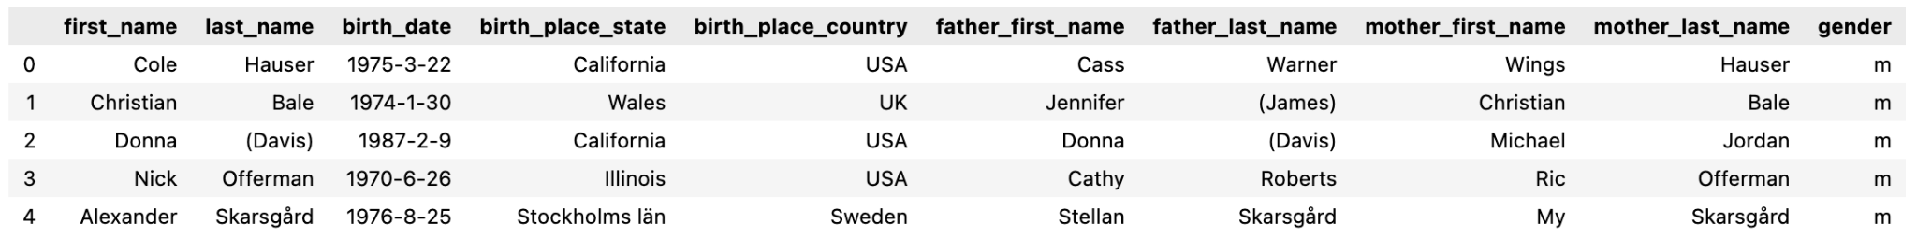
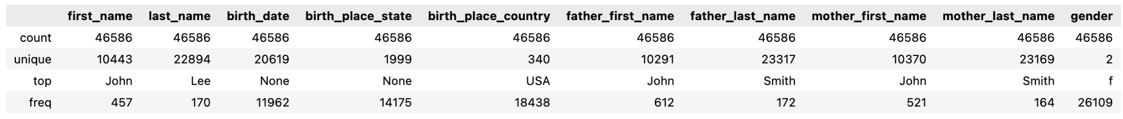
Getting to know the data
11 Features & ~4M rows

Slide 5
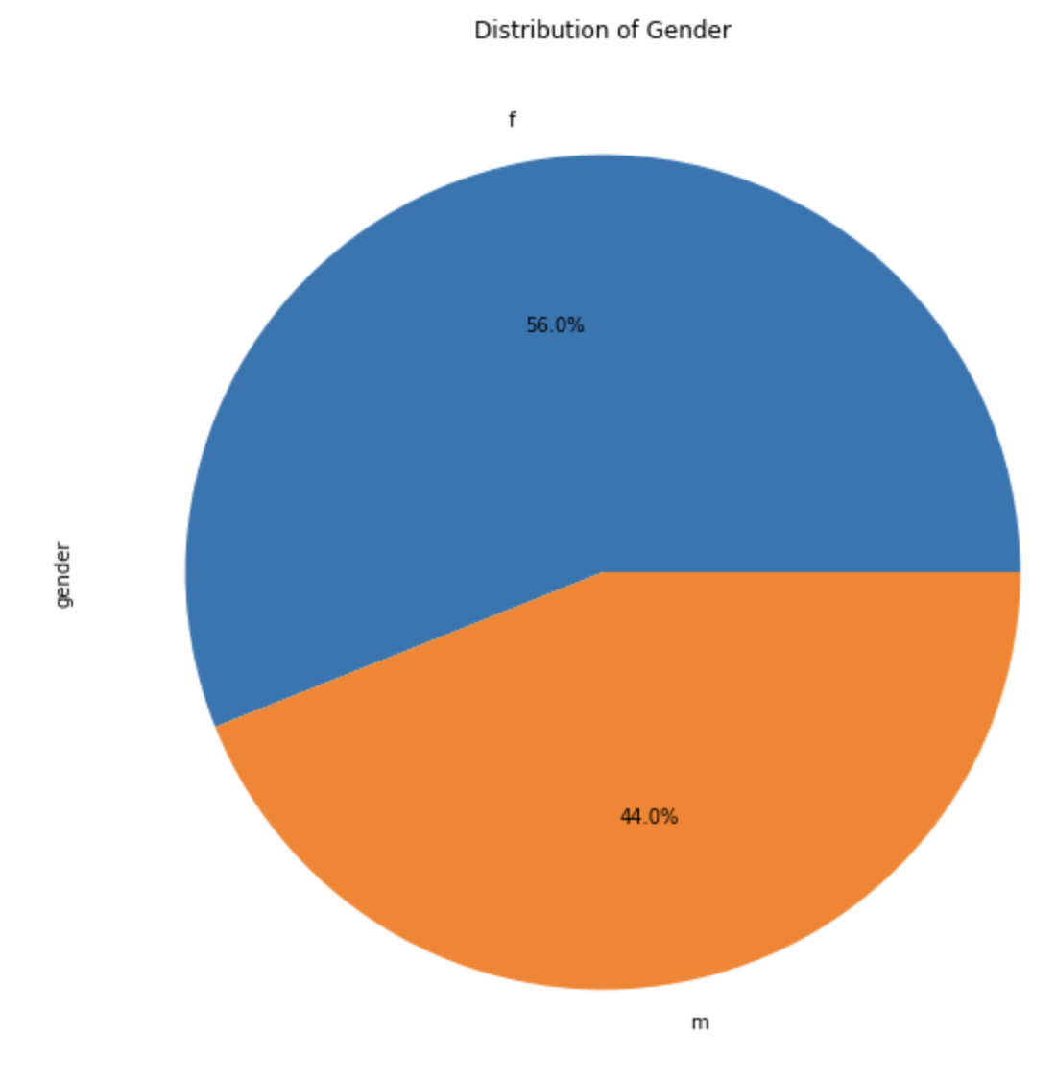
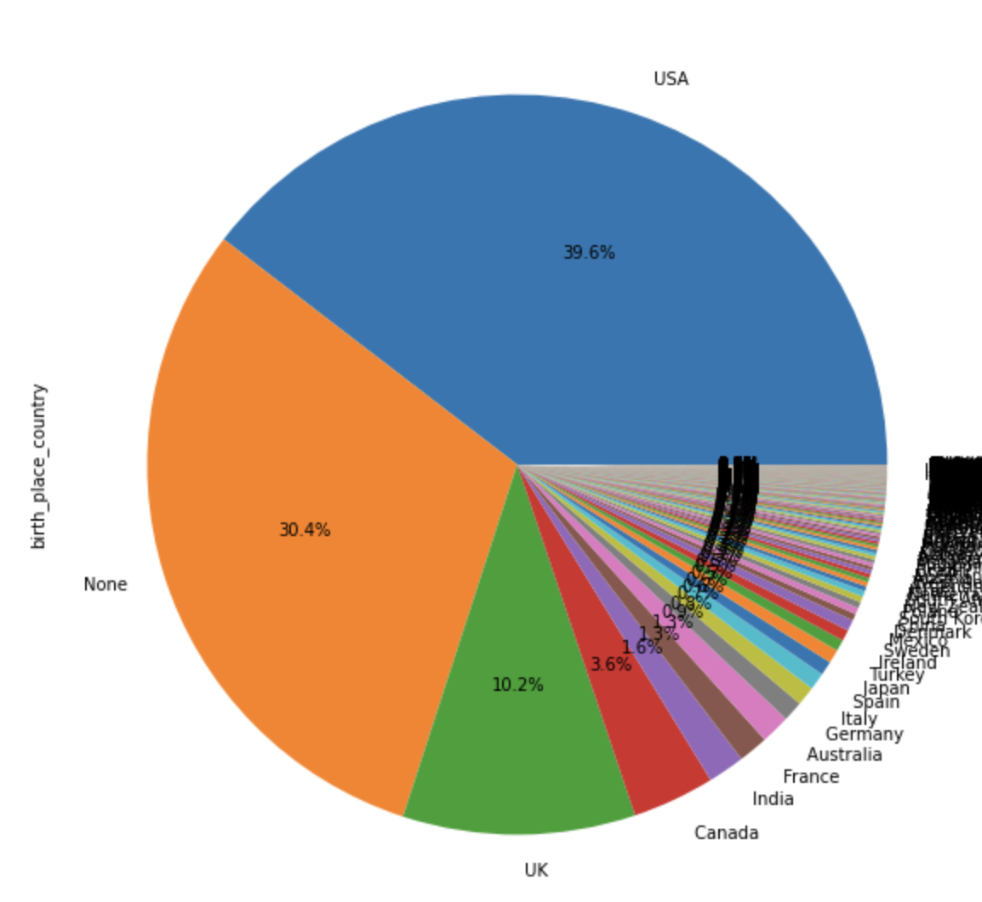
Data Statistics
Have almost same ratio of Males and Females => No bias towards any gender

Slide 6
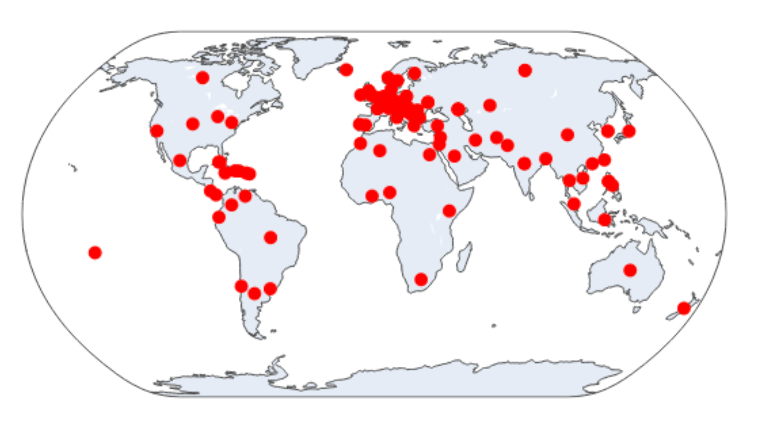
Data Statistics
The people data used, covers almost all countries
=> No bias towards certain countries
Plotted using “plotly”^{[3]} and “geopy”^{[4]}

Slide 7
Data Preprocessing
Feature Name
Affected number of rows
First_name
last_name
Birth_date
Birth_place_state
birth_place_country
Father_first_name
father_last_name
Mother_first_name
mother_last_name
Gender
ethnicity
fillNA with Father_first_name or mother_first_name
fillNA with Father_last_name or mother_last_name
fillNA with random pre-decided date
fillNA with most common state
fillNA with most common country
fillNA with first_name
fillNA with last_name
fillNA with first_name
fillNA with lastt_name or father_last_name
No missing values
fillNA with most common one
Else drop the row
1668
182
0
0
0
35971
35972
39007
39008
No missing values
fillNA with most common one
13

Slide 8
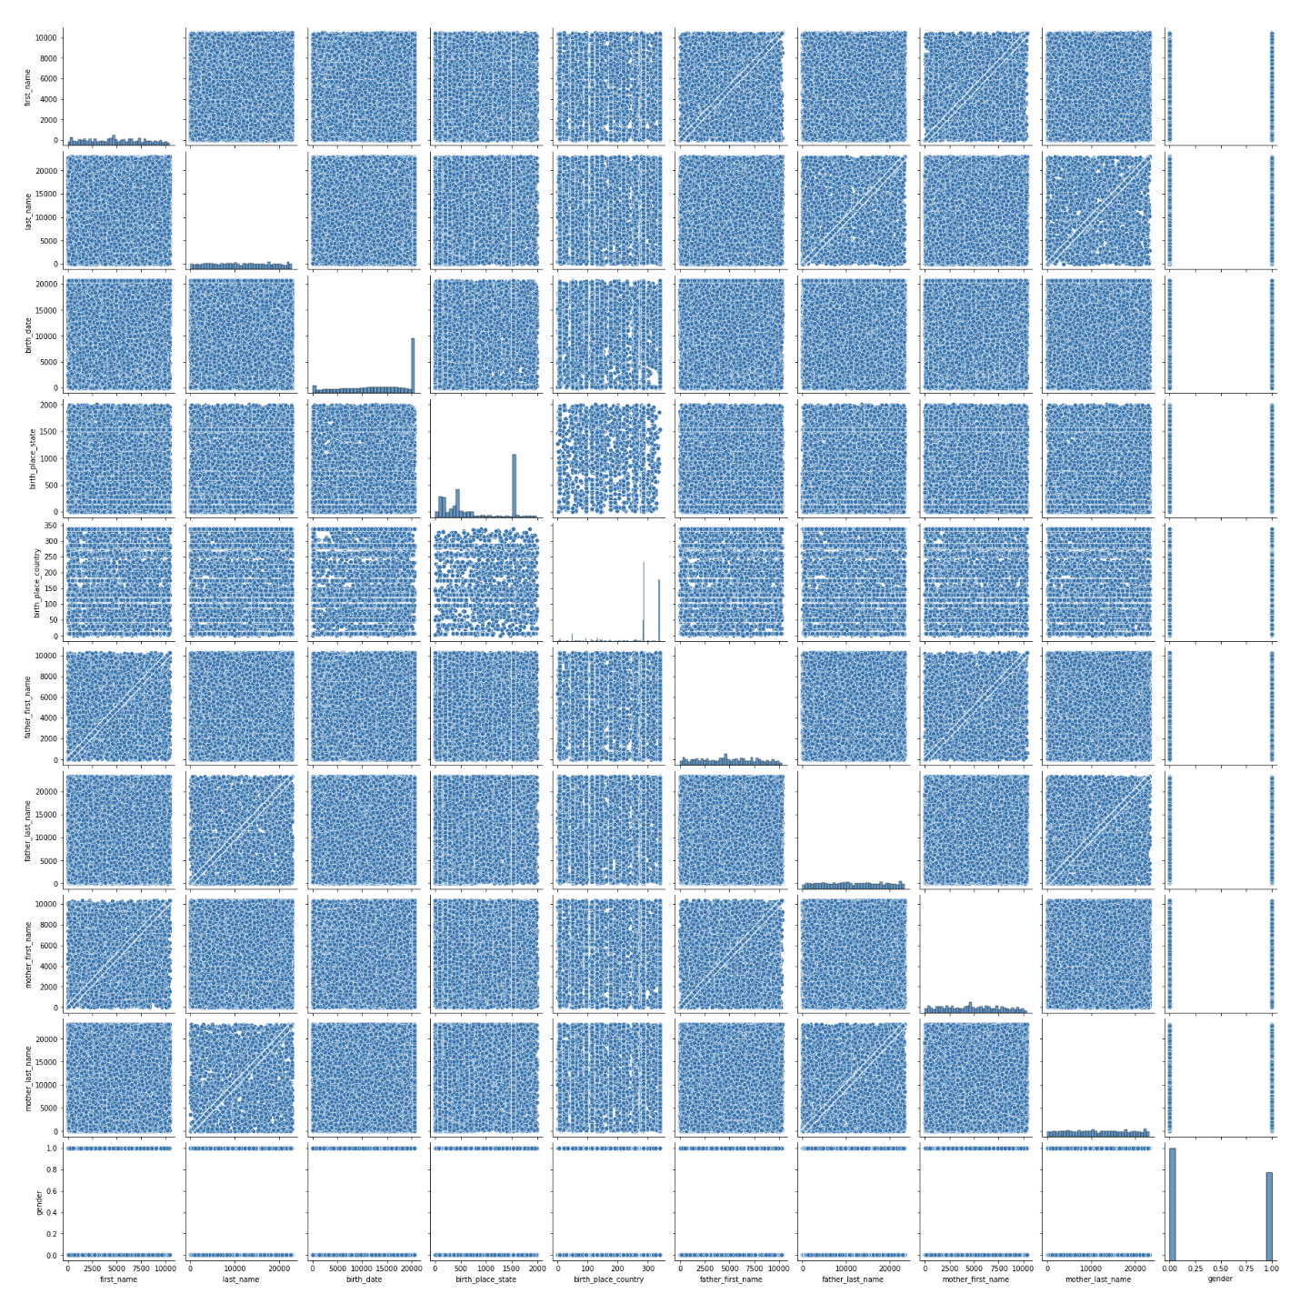
Feature Engineering
After Encoding the text data to numerical form, plotted PairPlot but this did NOT provided any meaningful correlation information.
=> Might need to change the text encoder and try different ones

Slide 9
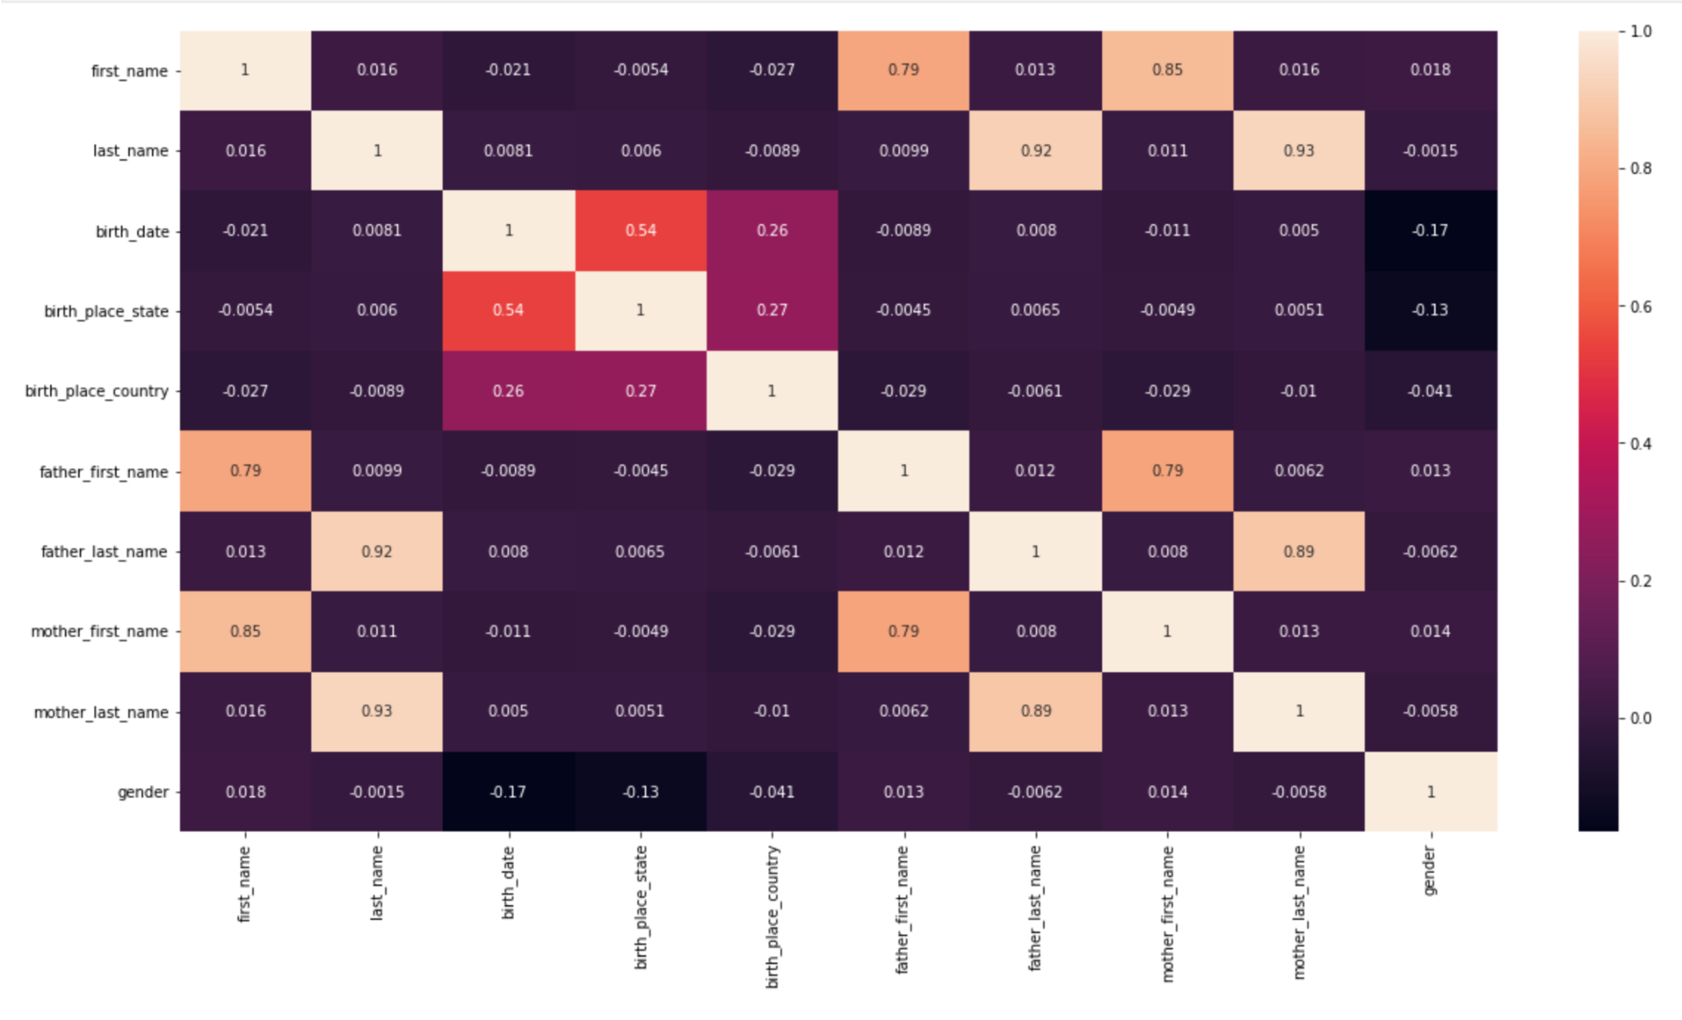
Feature Engineering
HeatMap provided good correlation information.
Shows that the first_name (Target) is highly correlated to father_first_name and mother_first_name.

Slide 10
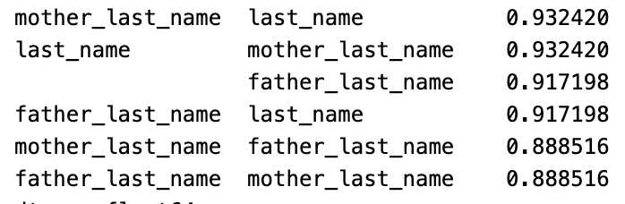
Feature Engineering
Top 5 correlated features

Slide 11
Ongoing work
Data Preprocessing and cleaning
Feature Engineering
Researching about GAN ML model
Researching evaluation strategy
Creating easy to use user interface for the software

Slide 12
References
https://www.crummy.com/software/BeautifulSoup/bs4/doc/
https://pypi.org/project/requests/
https://plotly.com/python/scatter-plots-on-maps/
https://geopy.readthedocs.io/en/stable/
https://pypi.org/project/folium/0.1.5/

Slide 13
Thank you

